Slide 1
Transaction Management and Concurrency Control
Notes:
1

Slide 2
What Is a Transaction?
A transaction is a logical unit of work
that must be either entirely completed or aborted;
no intermediate states are acceptable.
  Most real-world database transactions are formed by two or more database requests.
  A database request
  is a single SQL statement in an application program or transaction.
Notes:
4

Slide 3
What Is a Transaction?
A consistent state
is one which all data integrity constraints are satisfied.
  A transaction that changes the contents of the database must alter the database
  from one consistent database state to another.
  To ensure consistency of the database,
  every transaction must begin with the database in a known consistent state.
consistent
state
consistent
state
transaction
database requests
Notes:
4

Slide 4
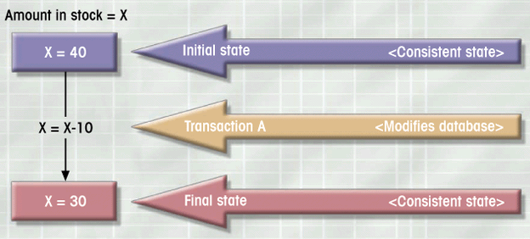
Example Of A Transaction
  As this transaction is taking place,
  the DBMS must ensure that no other transaction access X.
Read ➔ Modify ➔ Write
Figure 9.1
Notes:
5

Slide 5
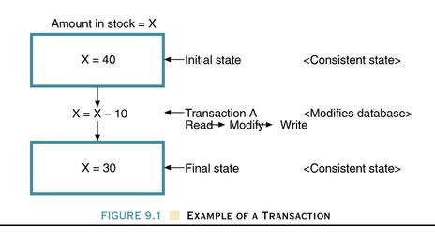
Example Of A Transaction
  A transaction is a logical unit of work
  that must be either entirely completed or aborted
Y = 50
X = X - 10
Y = Y + 10
Y = 60
Notes:
5

Slide 6
What Is a Transaction?
Evaluating Transaction Results
  Examining the current balance for an account:
    SELECT ACC_NUM, ACC_BALANCE
    FROM CHECKACC
    WHERE ACC_NUM = ‘0908110638’;
    represents a transaction because we accessed the database.
    The database remains in a consistent state after the transaction, because it did not alter the database.
Notes:
6

Slide 7
What Is a Transaction?
Evaluating Transaction Results
  An accountant wishes to register the credit sale of 100 units of product X to customer Y in the amount of $500.00:
    Reducing product X’s Quantity on hand by 100.
    Adding $500.00 to customer Y’s accounts receivable.
    UPDATE PRODUCT
    SET PROD_QOH = PROD_QOH - 100
    WHERE PROD_CODE = ‘X’;
    UPDATE ACCREC
    SET AR_BALANCE = AR_BALANCE + 500
    WHERE AR_NUM = ‘Y’;
    If the above two transactions are not completely executed, the transaction yields an inconsistent database.
    The DBMS must be able to recover the database
    to a previous consistent state.
A real-world
transaction
Notes:
7

Slide 8
What Is a Transaction?
Evaluating Transaction Results
  The DBMS does not guarantee
  that the semantic meaning of the transaction truly represents the real-world event.
    Although the syntax of the following UPDATE command is correct, its use yields incorrect results.
      UPDATE PRODUCT
      SET PROD_QOH = PROD_QOH + 10
      WHERE PROD_CODE = ‘X’;
Notes:
8

Slide 9
What Is a Transaction?
Transaction Properties
  Atomicity
    All transaction operations must be completed
    Incomplete transactions aborted
  Durability
  permanence of the database’s consistent state.
  Serializability
    concurrent transactions are treated as though they were executed in serial order (one after another).
    important in multi-user and distributed databases.
  Isolation
  means that the data used during the execution of a transaction cannot be used by a second transaction until the first one is completed.
Notes:
9

Slide 10
What Is a Transaction?
Transaction Management with SQL
  Transaction support is provided
    COMMIT
    ROLLBACK
  When a transaction sequence is initiated,
  it must continue through all succeeding SQL statements until one of the following four events occurs:
    A COMMIT statement is reached.
    The COMMIT statement automatically ends the SQL transaction.
    A ROLLBACK statement is reached.
    The end of a program is successfully reached ( = COMMIT).
    The program is abnormally terminated ( = ROLLBACK).
Notes:
10

Slide 11
What Is a Transaction?
Transaction Management with SQL
  Example:
    UPDATE PRODUCT
    SET PROD_QOH = PROD_QOH - 100
    WHERE PROD_CODE = ‘345TYX’;
    UPDATE ACCREC
    SET AR_BALANCE = AR_BALANCE + 3500
    WHERE AR_NUM = ‘60120010’;
    COMMIT;
  If UPDATE is the application’s last action and the application terminates normally
  ➔ COMMIT is not necessary
  A transaction begins implicitly when the first SQL statement is encountered.
  Some SQL (not follow ANSI) use: BEGIN TRANSACTION;
Notes:
11

Slide 12
What Is a Transaction?
The Transaction Log
  A transaction log
  keeps track of all transactions that update the database.
  The information stored in the log is used by the DBMS
  for a recovery requirement triggered by a ROLLBACK statement or a system failure.
  The transaction log
  stores before-and-after data about the database and any of the tables, rows, and attribute values that participated in the transaction.
  The transaction log is itself a database, and it is managed by the DBMS like any other database.
Notes:
12

Slide 13
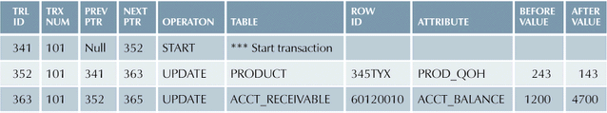
A Transaction Log
Before After
Table 9.1
Notes:
13

Slide 14
Concurrency Control
Concurrency control
coordinates simultaneous execution of transactions in a multiprocessing database.
  The objective of concurrency control is to
  ensure the serializability of transactions in a multi-user database environment.
  Simultaneous execution of transactions over a shared database can create several data integrity and consistency problems:
    Lost Updates.
    Uncommitted Data.
    Inconsistent retrievals.
Notes:
14

Slide 15
Concurrency Control
Lost Updates
  Two concurrent transactions update PROD_QOH:
  See Table 9.2 for the serial execution under normal circumstances.
  See Table 9.3 for the lost update problems resulting from the execution of the second transaction before the first transaction is committed.
TRANSACTION COMPUTATION
T1: Purchase 100 units PROD_QOH = PROD_QOH + 100
T2: Sell 30 units PROD_QOH = PROD_QOH - 30
Notes:
15

Slide 16
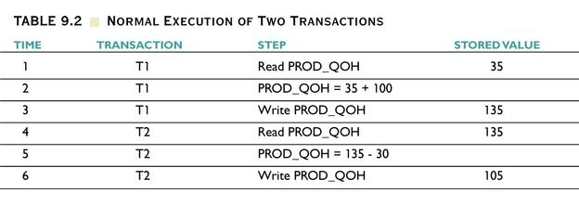
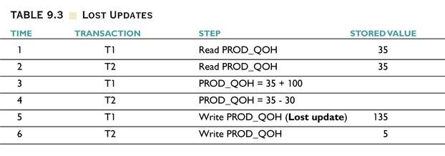
Notes:
16

Slide 17
Concurrency Control
Uncommitted Data
  Data are not committed when
  two transactions T1 and T2 are executed concurrently and the first transaction is rolled back after
  the second transaction has already accessed the uncommitted data –
  thus violating the isolation property of the transaction.
TRANSACTION COMPUTATION
T1: Purchase 100 units PROD_QOH = PROD_QOH + 100 (Rolled back)
T2: Sell 30 units PROD_QOH = PROD_QOH - 30
Notes:
17

Slide 18
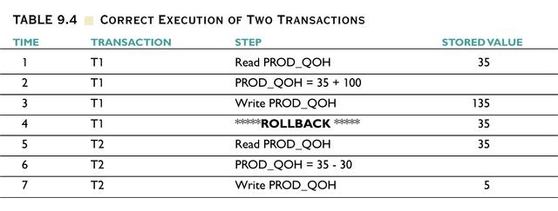
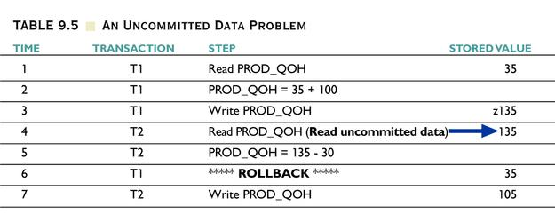
Notes:
18

Slide 19
Concurrency Control
Inconsistent Retrievals
  Inconsistent retrievals occur when a transaction calculates some summary (aggregate) functions over a set of data while other transactions are updating the data.
  Example:
    T1 calculates the total quantity on hand of the products stored in the PRODUCT table.
    At the same time, T2 updates the quantity on hand (PROD_QOH) for two of the PRODUCT table’s products.
Notes:
19

Slide 20
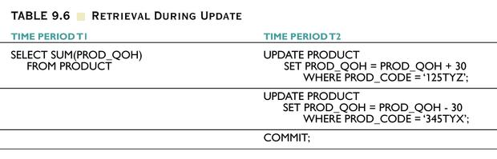
Retrieval During Update
T1
T2
Table 9.6
Notes:
20

Slide 21
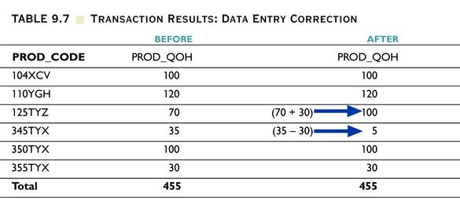
Transaction Results: Data Entry Correction
Table 9.7
Notes:
21

Slide 22
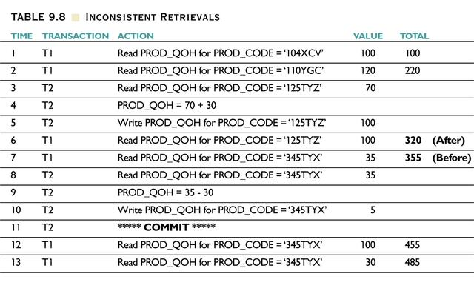
Inconsistent Retrievals
Table 9.8
Notes:
22

Slide 23
Concurrency Control
The Scheduler
  The scheduler establishes the order in which the operations within concurrent transactions are executed.
  The scheduler interleaves the execution of database operations to ensure serializability.
  To determine the appropriate order, the scheduler bases its actions on concurrency control algorithms, such as locking or time stamping methods.
  The scheduler also makes sure that the computer’s CPU is used efficiently.
Notes:
23

Slide 24
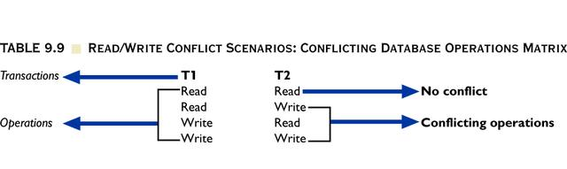
Read/Write Conflict Scenarios:
Conflicting Database Operations Matrix
T1 and T2 are executed concurrently over the same data.
Table 9.9
Notes:
24

Slide 25
Concurrency Control with
Locking Methods
Concurrency can be controlled using locks.
A lock guarantees exclusive use of a data item to a current transaction.
A transaction acquires a lock prior to data access; the lock is released (unlocked) when the transaction is completed.
All lock of information is managed by a lock manager.
Notes:
25

Slide 26
Concurrency Control with
Locking Methods
Lock Granularity
  Lock granularity indicates the level of lock use.
    Database level (See Figure 9.2)
    Table level (See Figure 9.3)
    Page level (See Figure 9.4)
    Row level (See Figure 9.5)
    Field level
Notes:
26

Slide 27
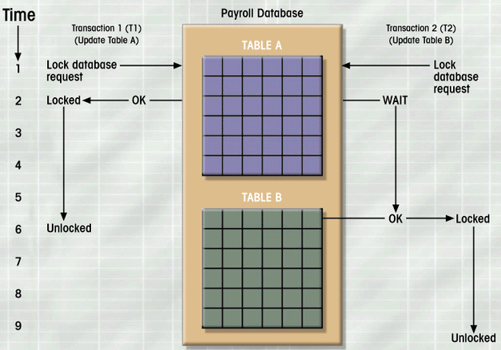
A Database-Level Locking Sequence
T1 and T2 cannot access the same database concurrently,
even if they use different tables.
T1( Update Table A )
T2( Update Table B )
Figure 9.2
Notes:
27

Slide 28
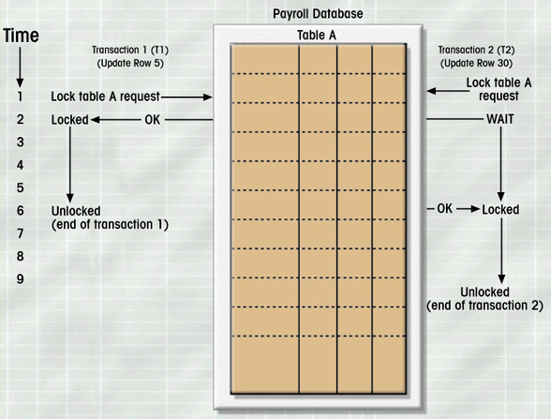
An Example Of A Table-Level Lock
T1 and T2 cannot access the same table concurrently,
even if they use different rows.
T1( Update Row 5 )
T2( Update Row 30 )
Figure 9.3
Notes:
28

Slide 29
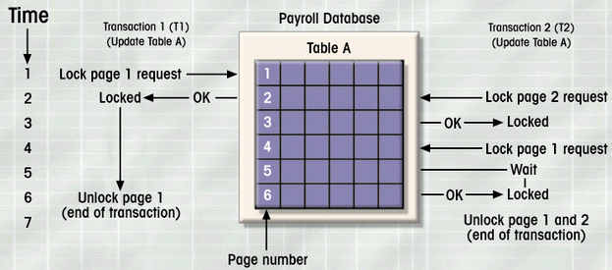
An Example Of A Page-Level Lock
T1 and T2 cannot access the same page concurrently,
even if they use different rows.
the most frequently used multiuser DBMS locking methods.
Figure 9.4
Notes:
29

Slide 30
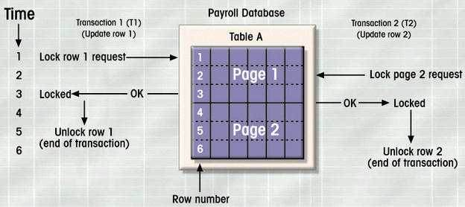
An Example Of A Row-Level Lock
Although it improves the availability of data,
its management requires high overhead cost.
row
Figure 9.5
Notes:
30

Slide 31
Concurrency Control with
Locking Methods
Lock types
  Binary Locks
  Shared/Exclusive Locks
Binary Locks
  A binary lock has only two states:
  locked (1) or unlocked (0).
  If an object is locked by a transaction,
  no other transaction can use that object.
  If an object is unlocked, any transaction can lock the object for its use.
  A transaction must unlock the object
  after its termination.
Notes:
31

Slide 32
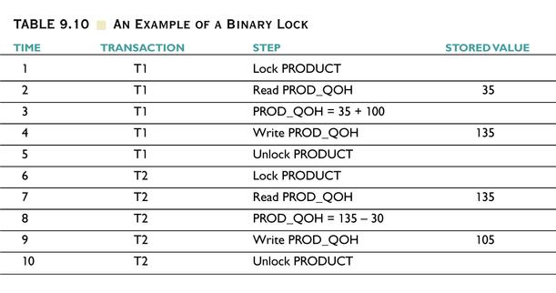
An Example Of A Binary Lock
Table 9.10
Notes:
32

Slide 33
Concurrency Control with Locking Methods
Shared/Exclusive Locks
(1)Exclusive Locks
An exclusive lock exists when access is specially reserved for the transaction that locked the object.
The exclusive lock must be used
when the potential for conflict exists.
issued when a transaction wants to
update unlocked data item.
Notes:
33

Slide 34
Concurrency Control with Locking Methods
(2)Shared Locks
A shared lock exists
when concurrent transactions are granted READ access on the basis of a common lock.
A shared lock produces no conflict as long as the concurrent transactions are read only.
issued when a transaction wants to
read data and no exclusive lock is held on that data item.
Notes:
33

Slide 35
Concurrency Control with Locking Methods
Shared/Exclusive Locks
Although the possibility of shared locks renders data access more efficient,
a shared/exclusive lock schema increases the lock manager’s overhead.
Three lock operations needed:
  READ_LOCK(check the type of lock)
  WRITE_LOCK(issue the lock)
  UNLOCK(release the lock)
Notes:
33

Slide 36
Concurrency Control with Locking Methods
Shared/Exclusive Locks
Current Want to | Unlock | Shared Lock | Exclusive Lock
Read | Shared Lock | Shared Lock | Wait
Write | Exclusive Lock | Wait | Wait
Notes:
33

Slide 37
Concurrency Control with Locking Methods
Although locks prevent serious data inconsistencies, Potential Problems with Locks
  The resulting transaction schedule may not be serializable.
  The schedule may create deadlocks.
Solutions
  Two-phase locking for the serializability problem.
  Deadlock detection and prevention techniques for the deadlock problem.
Notes:
35

Slide 38
Concurrency Control with Locking Methods
Two-Phase Locking
  The two-phase locking protocol defines how transactions acquire and relinquish locks.
  It guarantees serializability,
  but it does not prevent deadlocks.
  In a growing phase,
  a transaction acquires all the required locks without unlocking any data.
  Once all locks have been acquired,
  the transaction is in its locked point.
  In a shrinking phase,
  a transaction releases all locks and cannot obtain any new locks.
Notes:
36

Slide 39
Concurrency Control with Locking Methods
Rules for Two-Phase Locking Protocol
  Two transactions cannot have conflicting locks.
  No unlock operation can precede a lock operation in the same transaction.
  No data are affected until all locks are obtained –
  that is, until the transaction is in its locked point.
Notes:
37

Slide 40
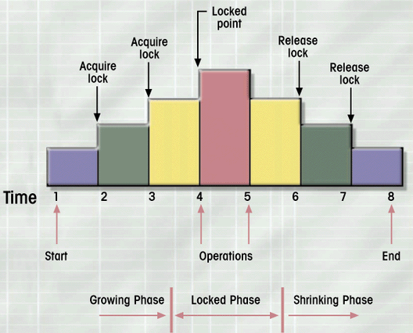
Two-Phase Locking Protocol
Figure 9.6
Notes:
38

Slide 41
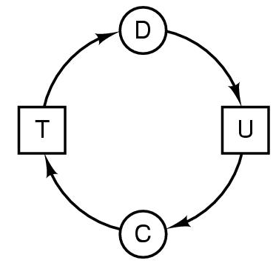
Concurrency Control with Locking Methods
Deadlocks (Deadly Embrace)
  Occurs when two transactions wait for each other to unlock data
  Deadlocks exist when two transactions T1 and T2 exist in the following mode:
    T1 = requests X and holds Y
    T2 = requests Y and holds X
  If T1 has not unlocked data item Y, T2 cannot begin; and, if T2 has not unlocked data item X, T1 cannot continue. (See Table 9.11)
holds
T1
requests
Y
X
requests
T2
holds
Notes:
39

Slide 42
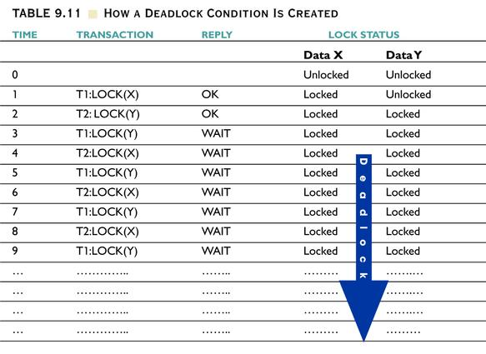
How A Deadlock Condition Is Created
Table 9.11
Notes:
40

Slide 43
Four Conditions for Deadlock
All four of these conditions must be present :
Mutual exclusion condition
  each resource assigned to 1 process or is available
Hold and wait condition
  process holding resources can request additional
No preemption condition
  previously granted resources cannot forcibly taken away
Circular wait condition
  must be a circular chain of 2 or more processes
  each is waiting for resource held by next member of the chain

Slide 44
Concurrency Control with Locking Methods
Three Techniques to Control Deadlocks:
  Deadlock Prevention
  A transaction requesting a new lock is aborted
  if there is a possibility that a deadlock can occur.
  Deadlock Detection
  The DBMS periodically tests the database for deadlocks.
  If a deadlock is found, one of the transactions (“victim”) is aborted, and the other transaction continues.
  Deadlock Avoidance
  The transaction must obtain all the locks it needs before it can be executed.
  Avoid deadlocks by allocating resources carefully.
Notes:
41

Slide 45
Concurrency Control with
Time Stamping Methods
The time stamping approach
assigns a global unique time stamp to each transaction to schedule concurrent transactions.
The time stamp value produces an explicit order in which transactions are submitted to the DBMS.
Time stamps must have two properties:
  Uniqueness
  assures that no equal time stamp values can exist.
  Monotonicity
  assures that time stamp values always increase.
The DBMS executes conflicting operations
in time stamp order to ensure the serializability.
Notes:
42

Slide 46
Concurrency Control with Optimistic Methods
Optimistic Methods
  It is based on the assumption
  that the majority of the database operations do not conflict.
  A transaction is executed without restrictions
  until it is committed.
Notes:
43

Slide 47
Concurrency Control with Optimistic Methods
Optimistic Methods
  Each transaction moves through two or three phases:
    Read Phase:
    The transaction reads the database, executes the needed computations, and makes the updates to a private copy of the database values.
    All updates of the transaction are recorded in a temporary update file.
    Validation Phase:
    The transaction is validated to assure that the changes made will not affect the integrity and consistency of the database.
    Write Phase:
    The changes are permanently applied to the database.
  acceptable for mostly read or query database systems that require very few update transaction.
Notes:
43

Slide 48
Database Recovery Management
Recovery restores a database
from a given state, usually inconsistent,
to a previously consistent state.
Recovery techniques are based on the atomic transaction property:
All portions of the transaction must be applied and completed to produce a consistent database.
If, for some reason, any transaction operation cannot be completed, the transaction must be aborted, and any changes to the database must be rolled back.
Notes:
44

Slide 49
Database Recovery Management
Levels of Backup
  Full backup of the database
  It backs up or dumps the whole database.
  Differential backup of the database
  Only the last modifications done to the database are copied.
  Backup of the transaction log only
  It backs up all the transaction log operations that are not reflected in a previous backup copy of the database.
Notes:
45

Slide 50
Database Recovery Management
Database Failures
  Software
    Operating system, DBMS, application programs, viruses
  Hardware
    Memory chip errors, disk crashes, bad disk sectors, disk full errors
  Programming Exemption
    Application programs (a withdrawal of zero balance account)
  Transaction
    Deadlocks
  External
    Fire, earthquake, flood
Notes:
46

Slide 51
Database Recovery Management
Transaction Recovery Procedures:
  Deferred-write/Deferred-update
  Transaction operations do not immediately update the database. Instead, all changes are written to the transaction log.
  The database is updated only after the transaction reaches its commit point.
  Write-through/Immediate-update
  The database is immediately updated by transaction operations during the transaction’s execution, even before the transaction reaches its commit point.
  The transaction log is also updated.
  If a transaction fails, the database uses the log information to roll back the database.
Notes:
47

